Slide 1

Vision control
[1]

Slide 2



Project Team
FH-Prof. Dipl.-Ing. Dr. Wolfgang Werth
Heinz-Peter Liechtenecker, BSc MSc
Gregor Fritz
Laurenz Hundgeburth

Slide 3
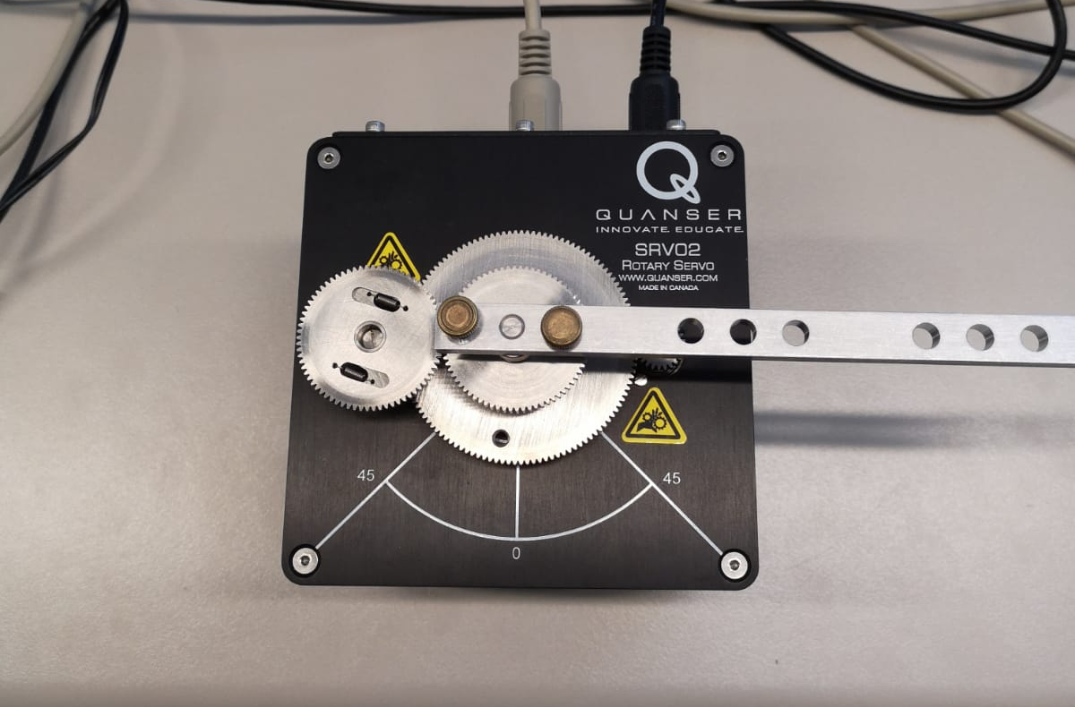
Goal
θ

Slide 4
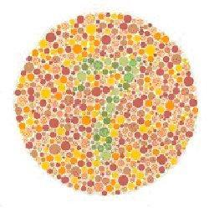

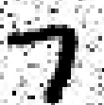
Machine Learning 1: Thought Experiment on Abstraction
Fig. 1 Seven
Fig. 2 Noisy Seven [2]
Fig. 3 Abstracted Seven [3]

Slide 5
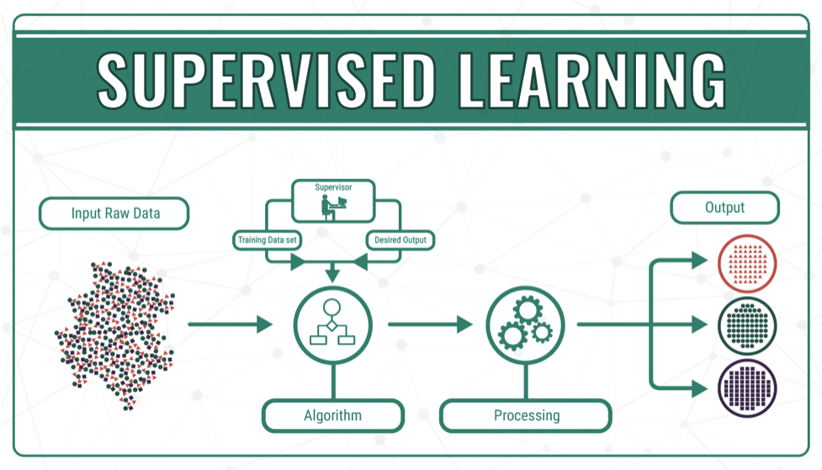
Machine Learning 2: Supervised Learning
Fig. 4 Supervised Learning[4]

Slide 6
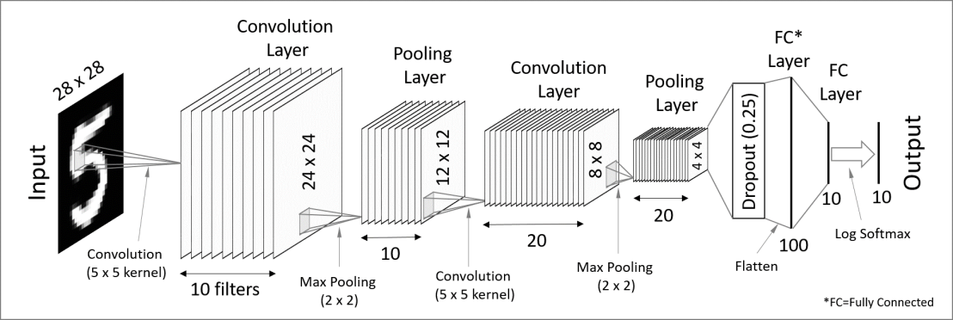
Machine Learning 3: Model Implementation
Convolutional Neural Network
Fig. 5 Convolutional Neural Network [5]

Slide 7





Approach
Sensor
Control
Camera
Motor
USB
Motor Power
Motor Encoder
θ
Training
θ
PC
RS232
MCU
Fig. 6 Experimental Set-up

Slide 8
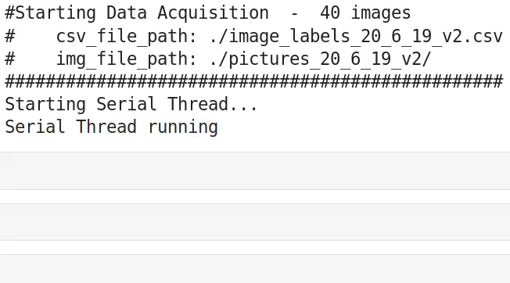
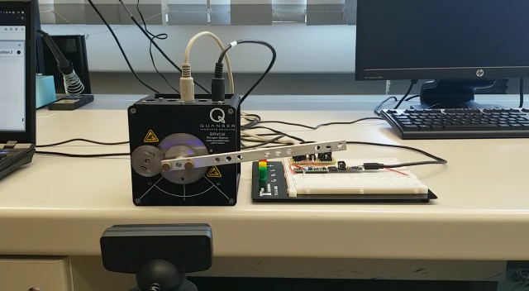
Data Acquisition
Vid. 1: Fully Automated, Multi-Threaded Image Data-Set Acquisition

Slide 9
PM 1: Timeline
PM
March
Feasibility Study
April
Camera
September
Data Acquisition
Model Training
Final Tests
Mai
June
August

Slide 10
PM 2: Costs
Budget: 1000 €
Items | Amount | Cost
Workhours (so far) | 120 | ☺
USB-Camera | 1 | 0 € (personal)
Tripod | 1 | 0 € (personal)
Camera holder | 1 | 0 € (3d printed)
Laptop | 2 | 0 € (personal)
Microcontroller | 1 | 0 € (FH - intern)
Servo-motor | 1 | 0 € (FH - intern)

Slide 11
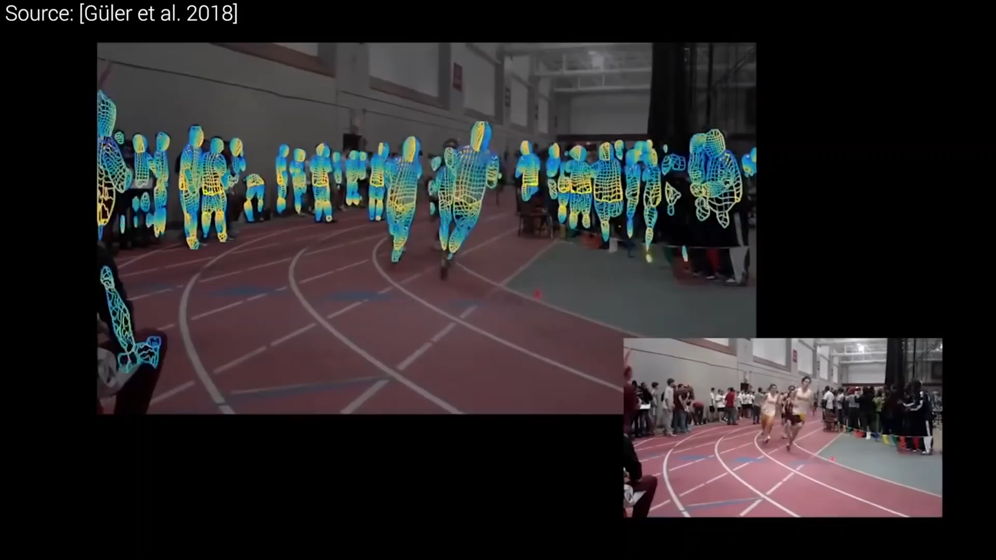
Recent Research
Vid. 2: Human Pose Estimation [6]

Slide 12

Thank You!

Slide 13
Bibliography
[1]: http://ia-latam.com/2019/01/28/la-ia-se-integrara-en-la-mayoria-de-los-aspectos-de-la- vida-humana/
[2]: http://www.marcelhaas.com/index.php/author/marcelhaas_em0ahm/
[3]: http://www.uni-koeln.de/~jschween/spiel/farbtafeln/farbtafeln.html
[4]: https://medium.com/@himanshuit3036/supervised-learning-methods-using-python-bb85b8c4e0b7
[5]: https://codetolight.wordpress.com/2017/11/29/getting-started-with-pytorch-for-deep-learning-part-3-neural-network-basics/
[6]: https://www.youtube.com/watch?v=F84jaIR5Uxc&t=10s

